Slide 1
Sara Steele Committee Meeting

Slide 2
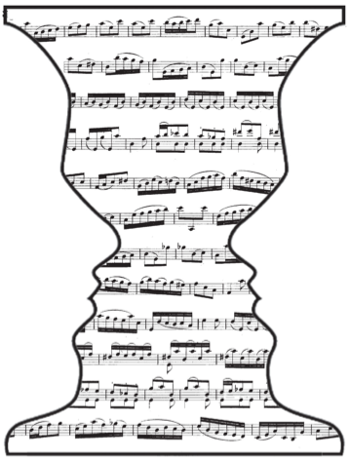
Topic review: The buildup of auditory stream segregation with alternations
Auditory scene analysis
Formation of auditory streams
Competition between perceptual organizations
Alternations for ambiguous stimuli
Pressnitzer, Suied, Shamma (2011)

Slide 3

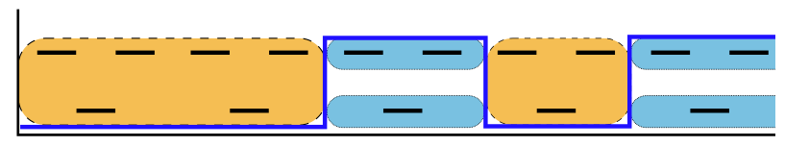
Experimental paradigm
++
time (s)
Daniel Pressnitzer, http://audition.ens.fr/sup/
van Noorden (1975)

Slide 4
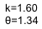
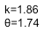
Buildup as alternating renewal process
grouped
MLE fit
+
p(2 streams)
split
+
+
trial average
ARP prediction
+
++

Slide 5
Features of buildup
For long presentations, stimulus elicits perceptual alternations
First percept is (usually) always integration
(Weak) No first order correlations between subsequent percept durations
Steele, Tranchina, Rinzel (2015)
++

Slide 6
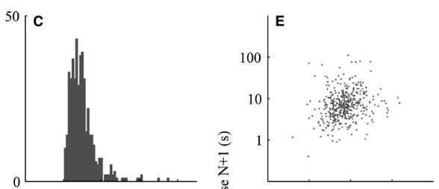
Percept to percept correlations
Percept duration
Percept N duration
++
Pressnitzer & Hupe, 2006

Slide 7
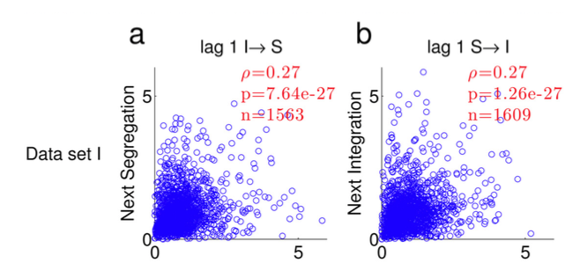
Percept to percept correlations
++
Barniv & Nelken, 2015

Slide 8
Update: human data
15 participants, 3-5 blocks of 8 DF conditions, 4 minute trials
Stimuli – 125 msec tone durations, ABA_ with frequencies between 392 & 932 Hz
Minimum 30 – 120 sec between trials
Subjects performed 2AFC holding down one of 2 buttons to indicate percept
++
Rankin, Sussman & Rinzel (2015)

Slide 9
Human data- 8 subjs, 4 min trials x5

Slide 10
Introduction
Ambiguous auditory streaming stimulus
Small percept to percept correlations
What role does previous history play in dynamics of bistable perception? Does this elucidate neuronal mechanisms?
Statistical model
Neuronal simulations

Slide 11
Percept to percept correlations
++

Slide 12
Percept to percept correlations
++

Slide 13
Percept to percept correlations
++

Slide 16
Finding significant correlations
Because we had limited samples for equidominant conditions for each subject, I wanted to adjust for sample size
Fisher transformed r is normally distributed with standard error 1/sqrt(n-3)
So I took fisher transformed r, divided by the standard error, to find how many standard errors each measurement was from zero (“Z score”)
Under null hypothesis of no true correlation, these pairs of Z scores would have bivariate normal distribution
I call a set of correlations “significant” if the pair of z scores has enough distance from the origin (sqrt(z1^2 + z2^2)>2.447)

Slide 17
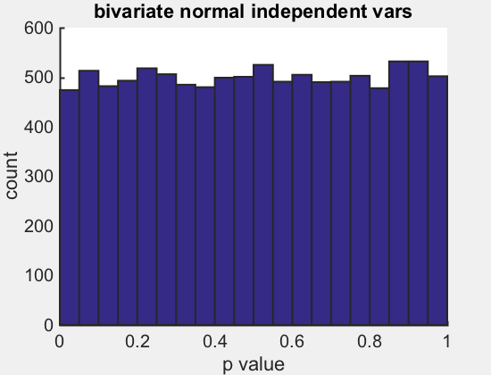
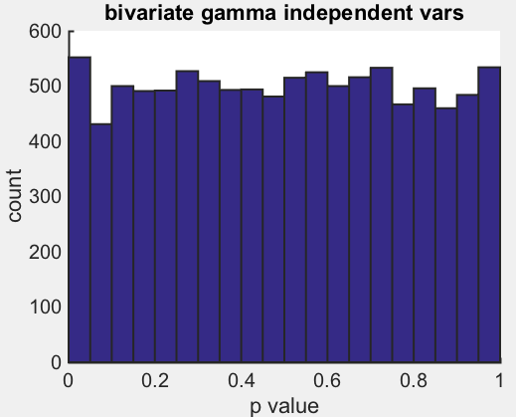
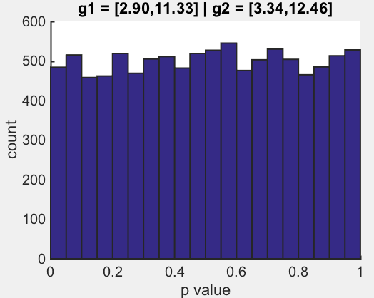
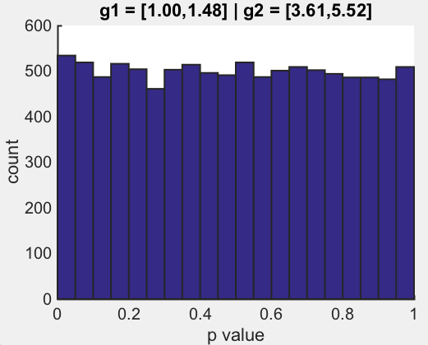
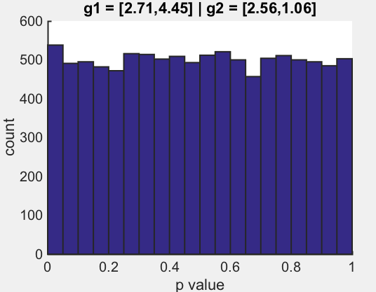
A brief Monte Carlo simulation of p values for independent gamma correlations
z_{r2}
++
z_{r1}

Slide 18
Percept to percept correlations
++

Slide 19
++

Slide 20
++

Slide 24
Cumulative history
?
state 2
state 1
?
?
state 2
state 1
time (s)
Does the duration of the next percept depend on previous history?
Can we make a full statistical description of the process?
++

Slide 25
Introduction
Statistical model
History function H(t; τ)
T (duration) vs H
Estimating parameters
Neuronal simulations

Slide 26
History function

Slide 27
History function
τ
Pastukhov & Braun, 2011, 2013

Slide 28
History function
τ
Pastukhov & Braun, 2011, 2013

Slide 29
History function
τ
Pastukhov & Braun, 2011, 2013

Slide 30
Is there a correlation between the value of H(t) at switch and next interval length?
H(t)
p(T|H(t)) =
Pastukhov & Braun, 2011, 2013

Slide 31
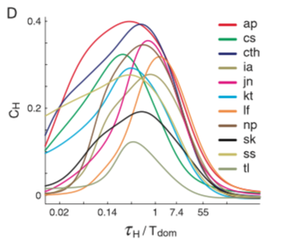
MaxR estimation of tau
Pastukhov 2011 BR
5/19 significant serial correlations
17/19 significant cumulative history correlations
Tau ~ Tdom/2
Pastukhov & Braun, 2011, 2013

Slide 32
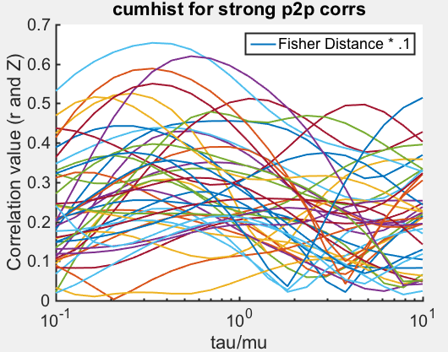
43/116 significant serial correlations
58/116 significant cumulative history correlations, but some with very short tau

Slide 33
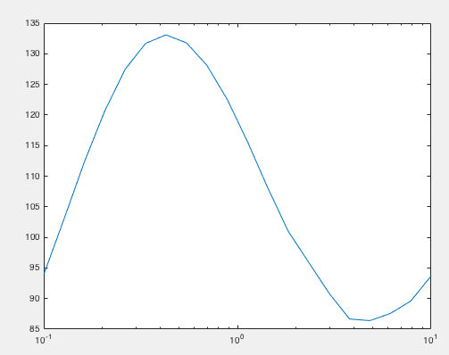

Slide 34
We specify a family of distributions such that the mean varies with H(t)
H(t)

Slide 35
We specify a family of distributions such that the mean varies with H(t)
H(t)
t₁
t₂
t₃
p(T|H(t_{j})) =
H₂(t₁)
H₂(t₂)
H₂(t₃)

Slide 36
Cumulative history model parameters
τ - time scale of the history function
k₁, k₂ – fixed shape parameter specifying gamma density
b₁, b₂ – log-mean at H_{x} = 0; “intercept”
m₁, m₂ – or alpha in p&B. Sensitivity to history; “slope”
Data
History
Conditional Distribution
τ

Slide 38
Durations vary with history

Slide 39
Durations vary with history
Mean varies by a factor of 2.7 with recent history

Slide 40
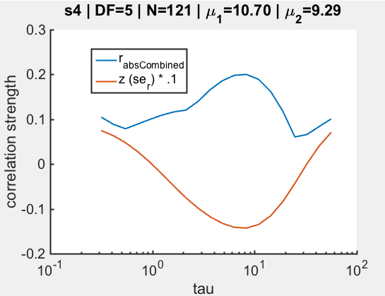
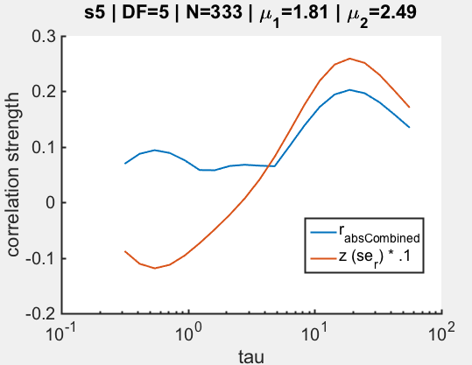
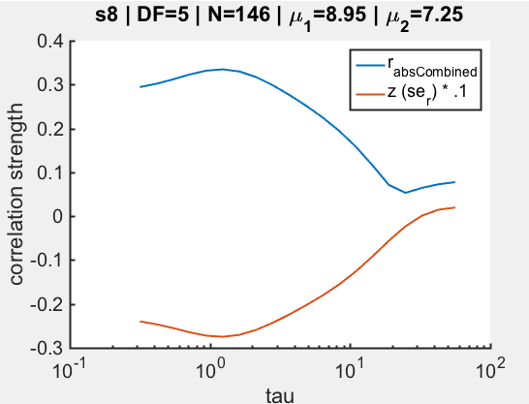
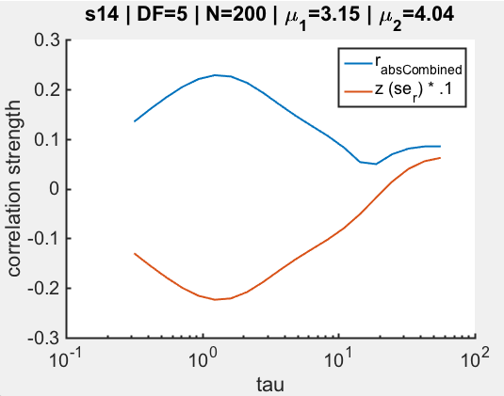
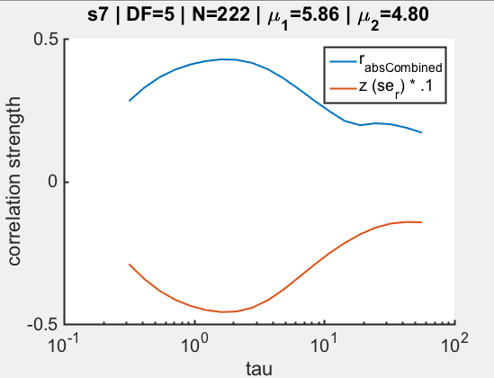
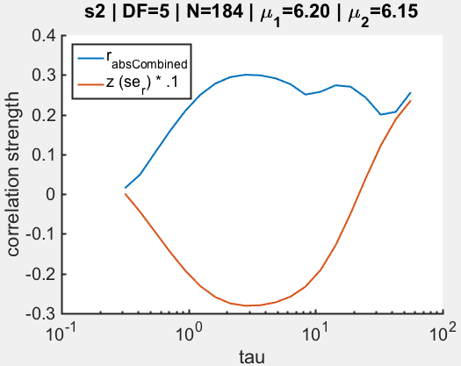
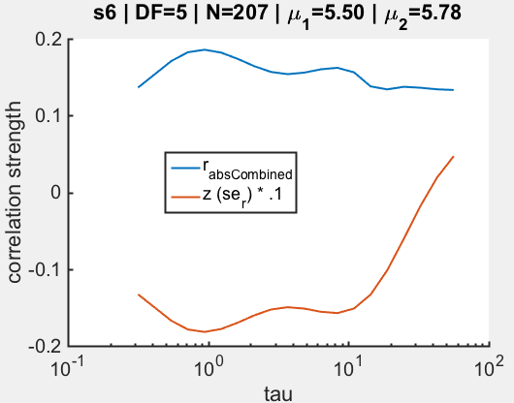
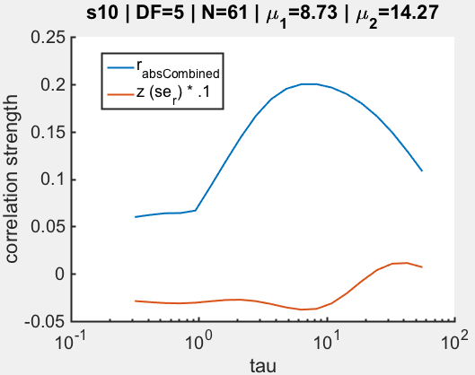
MaxR revisited
*
Sometimes we get a local max…
**
*
*
*

Slide 41
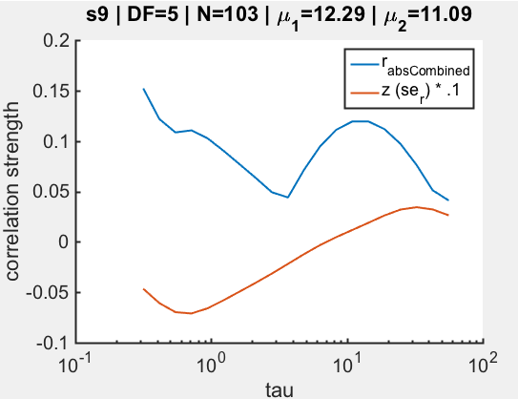
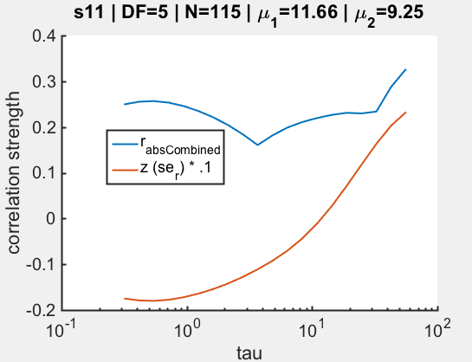
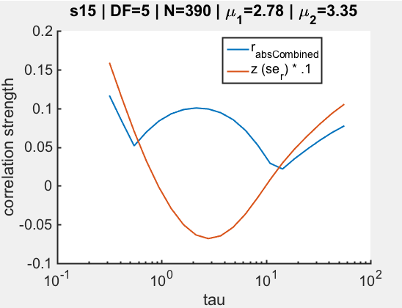
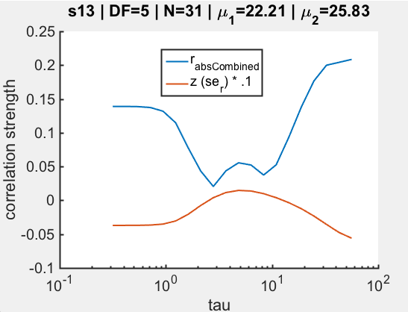
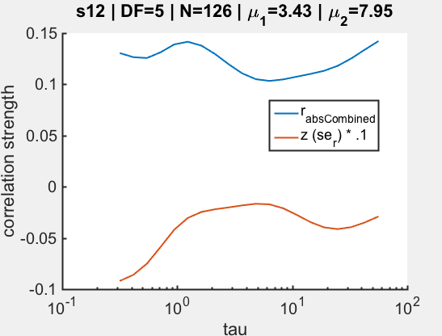
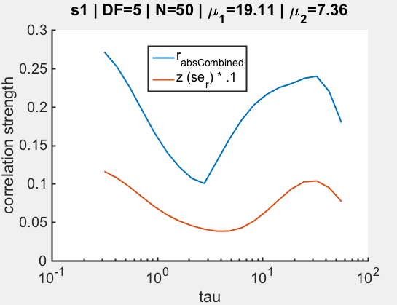
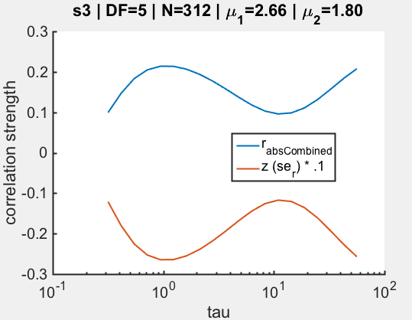
MaxR revisited
Sometimes significant corr’s aren’t bounded by tau, weird discontinuities
*
*
borderline?

Slide 42
Normalized equidominant?

Slide 43
Introduction
Statistical model
H(t; τ)
Duration drawn from one of a family of distributions for which mean is a function of H
Use MLE to find parameters
Neuronal simulations

Slide 44
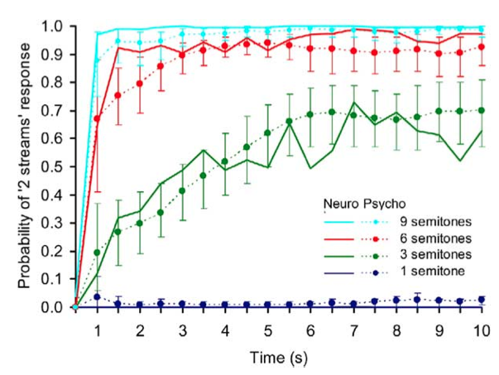
Buildup to stream segregation
++
Micheyl et. al. (2005)
human + monkey

Slide 45
Alternating renewal process
++

Slide 46
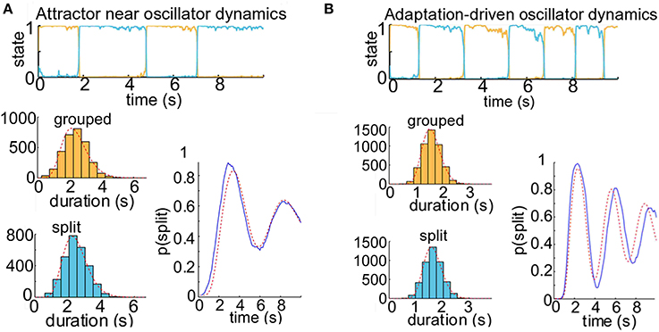
Alternative hypothesis: deviations observed with increasing adaptation
N>1000
++
r = .25
r = .3

Slide 47
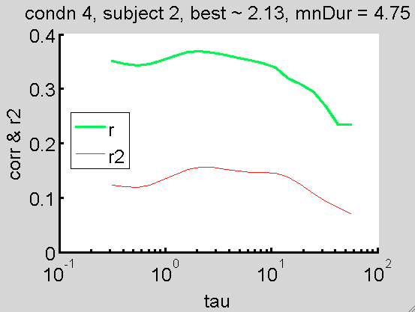
Analysis
++

Slide 48
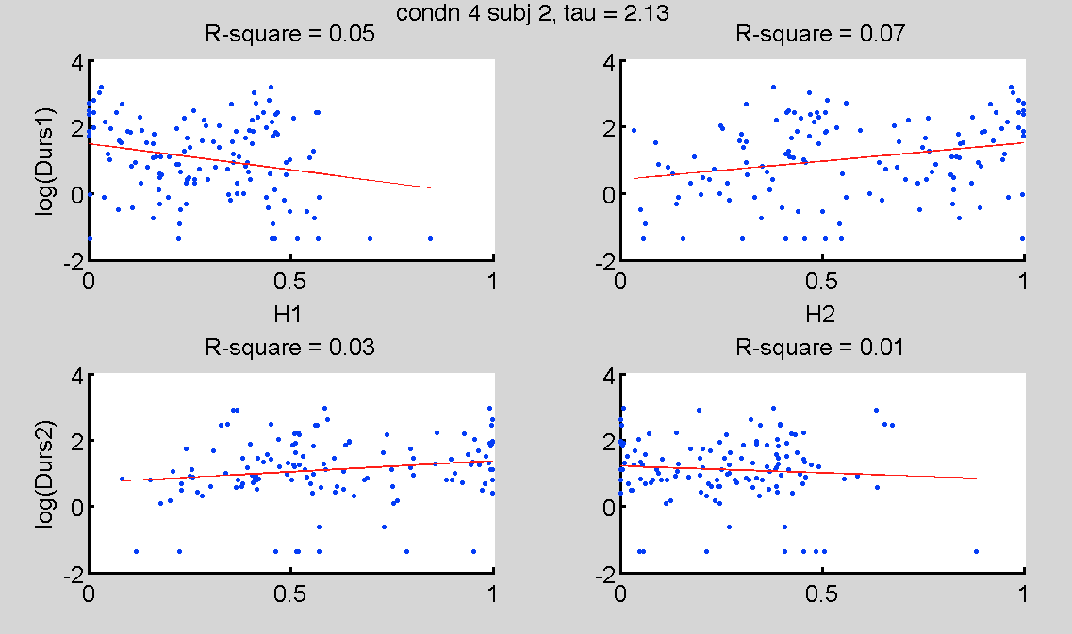
Analysis
++

Slide 49
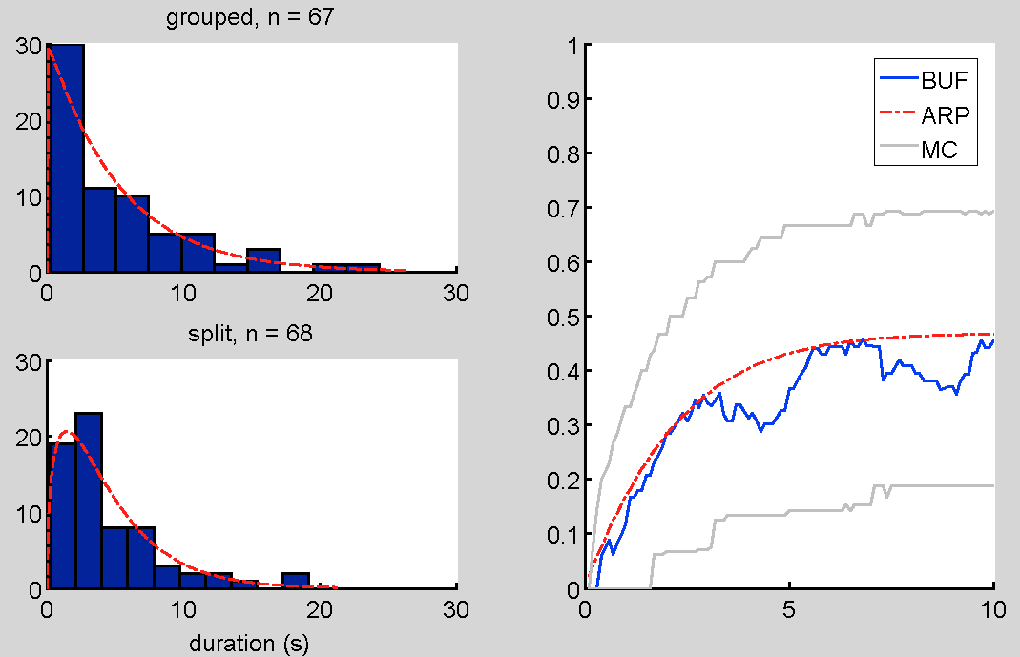
ARP provides good fit to psychophysical buildup functions
++

Slide 50
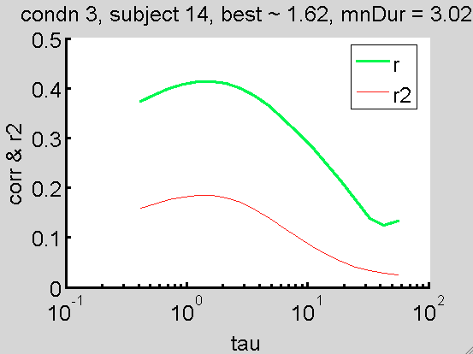
Analysis
++

Slide 51
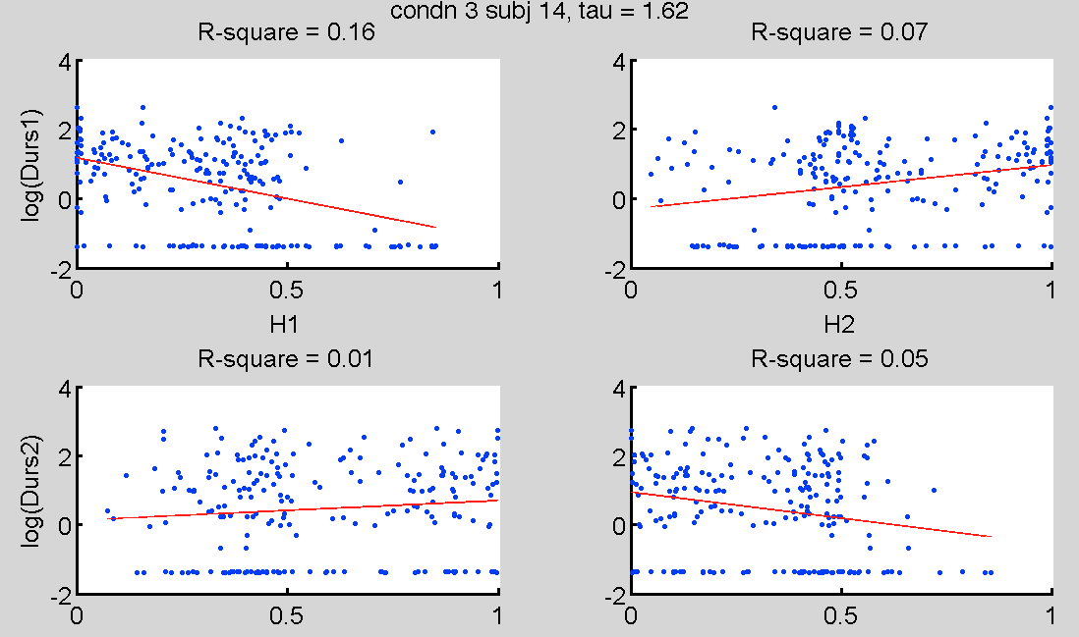
Analysis
++

Slide 52
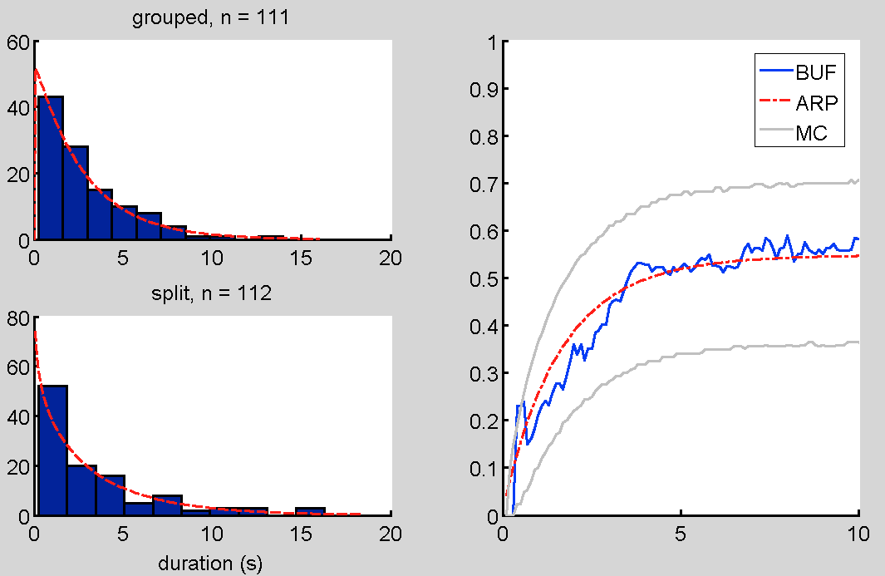
BUF
++

Slide 53
Further analysis
Use Monte Carlo simulations to generate data with significant history dependence and characterize deviations between BUF and ARP – how much data do we need?
Compute cumulative history measure in the data; novel application for ABA_ data
Combine data across subjects to get statistical power
++

Slide 54
Autoregressive generator
Ln(T) = a1 H1 + B + noise
++

Slide 55
Introduction
Statistical model
Neuronal simulations
How do neuronal parameters affect cumulative history?
What can cumulative history tell us about physiological processes?

Slide 56
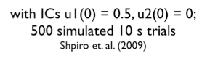
Competition model
Noisy input,
++

Slide 57
Competition models generate trial time courses
1299 samples
++

Slide 58
Distribution means vary with H according to exp(mx + B)

Slide 59
Distribution means vary with H according to mx + B

Slide 60
Distribution means vary with H according to exp(mx + B)

Slide 61
Distributions vary with H according to LnT = mH + B
Mean = 2.6
Mean = 0.9

Slide 62
Can cumulative history tell us about neuronal mechanism?
Mechanism of alternation?
Time scale of adaptation?

Slide 63
Oscillator: Ln(T) vs H

Slide 64
Oscillator: Ln(T) vs H
Parmhat:
k1 = 25.23
k2 = 31.57
b1 = .94
b2 = .95
m1 = -1.28
m2 = -1.27
Tau = 2.71
r = 0.35
fval (-LL) = 819

Slide 65
Competition Model- oscillator

Slide 66
Attractor (G=.3): ln(T) by H

Slide 67
Attractor (G=.3): ln(T) by H
Parmhat:
k1 = 5.64
k2 = 5.25
b1 = 1.06
b2 = 1.16
m1 = -.98
m2 = - 1.29
Tau = 2.24
fval (-LL) = 1169
Null:
k1 = 5.34
k2 = 4.83
b1 = .79
b2 = .80
m1 = 0
m2 = 0
Tau = “1”
fval (-LL) = 1202
2*(-1169-(-1202)) = 66 p~e-14

Slide 68
Attractor: histograms by H

Slide 69
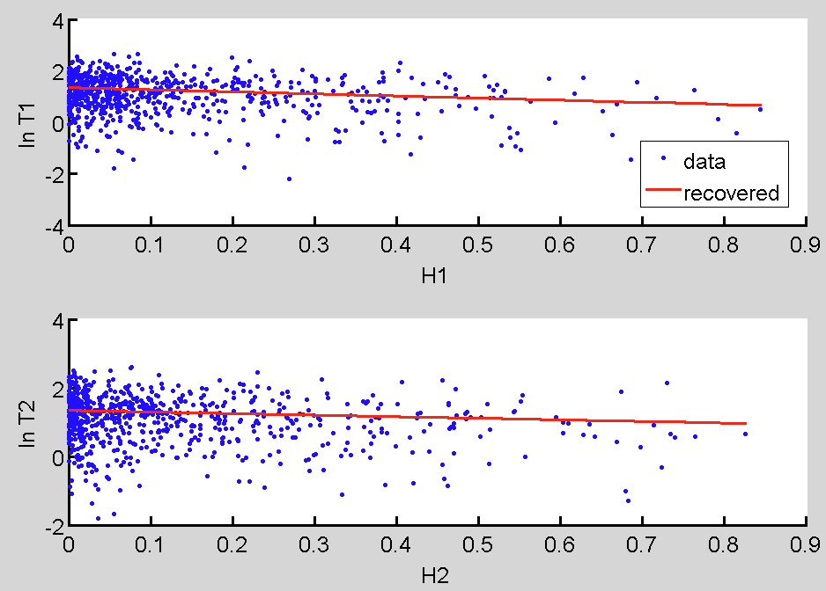
Attractor (G=.1): ln(T) by H
Parmhat:
k1 = 2.21
k2 = 2.49
b1 = 1.34
b2 = 1.34
m1 = -.81
m2 = - .45
Tau = 1.26
fval (-LL) =
2948
Null:
k1 = 2.24
k2 = 2.41
b1 = 1.27
b2 = 1.27
m1 = 0
m2 = 0
Tau = “1”
fval (-LL) = 2961
2*(-2961.4-(-2947.5)) = 66 p~1.9 e-6

Slide 70
Attractor (G=.1): ln(T) by H

Slide 71
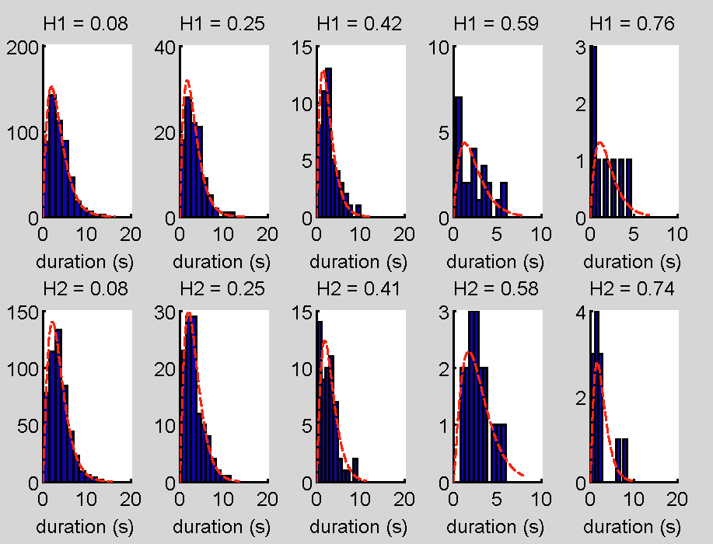
Attractor (G=.1): hists by H

Slide 72
Oscillator

Slide 73
Noisy Oscillator

Slide 74
Attractor near oscillator

Slide 75
Attractor near oscillator

Slide 76
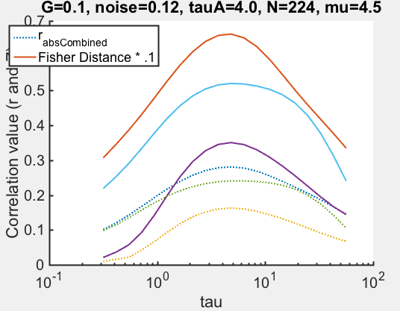
Attractor

Slide 77
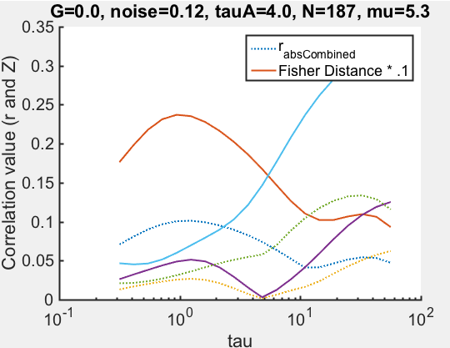
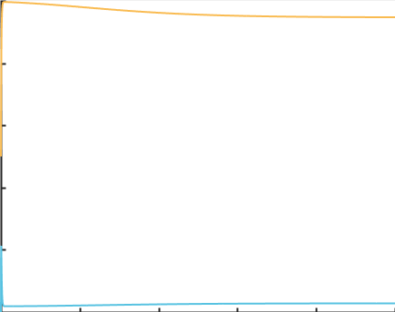

Slide 78
Fit model to simulated data with zero history dependence
K1 : 1.39
K2 : 1.34
B1 : 0.42
B2 : 0.60
M1 : 0.60
M2 : 0.05
Tau : 11.19
K1 : 1.38
K2 : 1.37
B1 : 0.69
B2 : 0.65
M1 : 0
M2 : 0
Tau : 1
(-4193 – (-4198)) = 2.495
Pval ~= .18
++

Slide 79
Percept corrs:
rIS = .33
rSI = .32
Zr_combined = 13
Cumhist:
Tau_tau_opt ~ 1.6 sec
Zr = -10.5

Slide 80
I need to see where tau_opt falls relative to the mean durations
Percept corrs:
rIS = .38
rSI = .38
ZrCombined = 12
Cumhist:
Tau_opt ~ 2.8
ZrCombined ~ -14

Slide 81
rIS = .31
rSI = .45
ZrCombined = 8.8
Tau_opt ~ 8.3
zMax = -10.9

Slide 84
Fitted model gives similar statistics

Slide 85
But there’s not a lot of consistency in the key parameters, tau & m

Slide 86
But there’s not a lot of consistency in the key parameters, tau & m

Slide 87
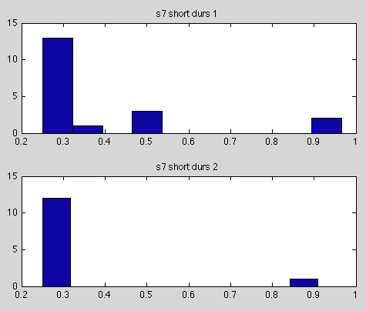
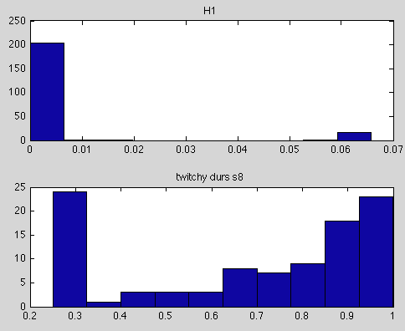
“twitchy” graphs

Slide 88
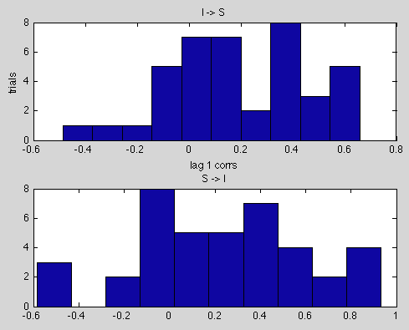
I-S and S-I corrs

Slide 89
To Do
Cross validation; compare MaxR to MLE
Buildup functions
Transient effects

Slide 90
But what about the stimulus?
??
++
+

Slide 91
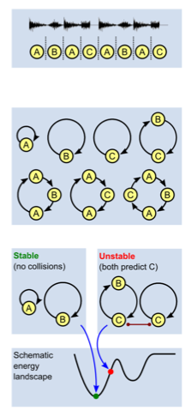
How does nervous system perform temporal integration?
++
Mill et al, 2013 – algorithmic formation of repeating sequences
Jin 2004 – spiking model for rapid input sequences (40 ms)

Slide 92
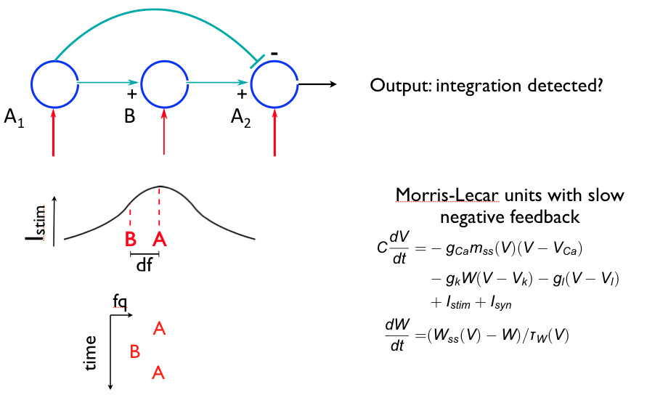
Sequence selective population

Slide 93
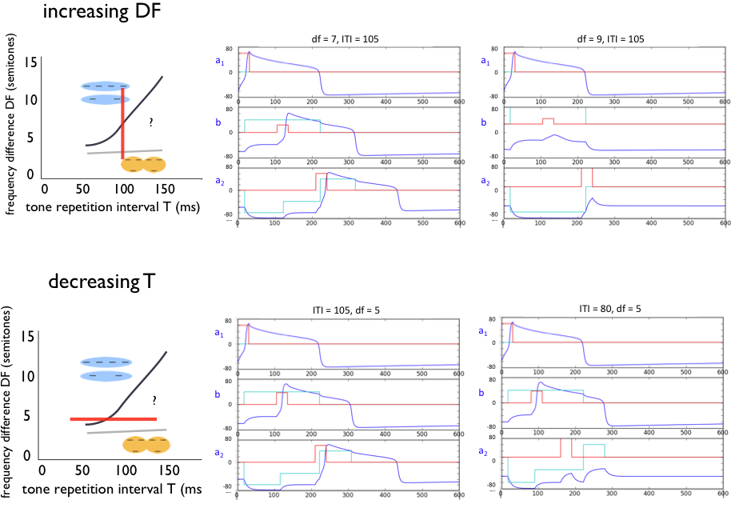
Sequence detector
Steele & Rinzel (2013) - APAN

Slide 94
Update: Wilson Cowan, synapses
-
*
+
+
+
NMDA
1
2
3

Slide 95
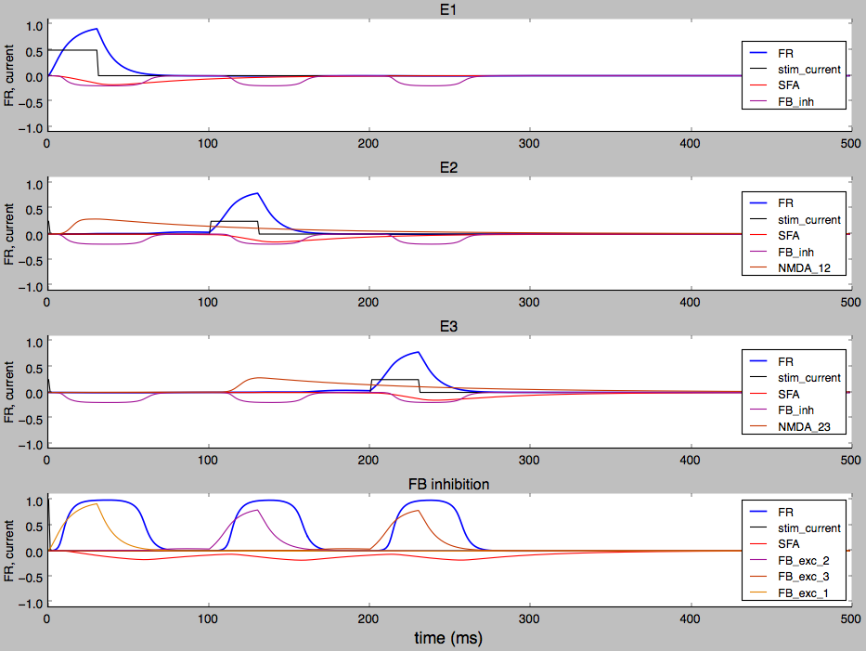
Fires for sequence in order
Firing rate
stim
NMDA
Feedback inhibition
*

Slide 96

but not out of order
Firing rate
stim
NMDA
Feedback inhibition
*

Slide 97

or too fast
Firing rate
stim
NMDA
Feedback inhibition
*

Slide 98
Acknowledgments
John Rinzel
Daniel Tranchina
Alex Reyes
Eero Simoncelli
Elyse Sussman
Amala Ankolekar-Hinge
Vik Keenan
Jason Mikiel-hunter
Josh Goldwyn
Stephen Keeley
Dan Levenstein
John D. Murray
Antje Ihlefeld
6th years

Slide 99




Parameter search

Slide 100
Analytical solution
++

